Slide 1
Chapter 2
Instructions: Language of the Computer
Notes:
The University of Adelaide, School of Computer Science
Chapter 2 — Instructions: Language of the Computer

Slide 2
Instruction Set
§2.1 Introduction
The repertoire of instructions of a computer
Different computers have different instruction sets
  But with many aspects in common
Early computers had very simple instruction sets
  Simplified implementation
Many modern computers also have simple instruction sets
Chapter 2 — Instructions: Language of the Computer — <number>
Notes:
The University of Adelaide, School of Computer Science
Chapter 2 — Instructions: Language of the Computer

Slide 3
The ARMv8 Instruction Set
A subset, called LEGv8, used as the example throughout the book
Commercialized by ARM Holdings (www.arm.com)
Large share of embedded core market
  Applications in consumer electronics, network/storage equipment, cameras, printers, …
Typical of many modern ISAs
  See ARM Reference Data tear-out card
Chapter 2 — Instructions: Language of the Computer — <number>
Notes:
The University of Adelaide, School of Computer Science
Chapter 2 — Instructions: Language of the Computer

Slide 4
Arithmetic Operations
Add and subtract, three operands
  Two sources and one destination
ADD a, b, c // a gets b + c
All arithmetic operations have this form
Design Principle 1: Simplicity favours regularity
  Regularity makes implementation simpler
  Simplicity enables higher performance at lower cost
§2.2 Operations of the Computer Hardware
Chapter 2 — Instructions: Language of the Computer — <number>
Notes:
The University of Adelaide, School of Computer Science
Chapter 2 — Instructions: Language of the Computer

Slide 5
Arithmetic Example
C code:
f = (g + h) - (i + j);
Compiled LEGv8 code:
ADD t0, g, h // temp t0 = g + h
ADD t1, i, j // temp t1 = i + j
SUB f, t0, t1 // f = t0 - t1
Chapter 2 — Instructions: Language of the Computer — <number>
Notes:
The University of Adelaide, School of Computer Science
Chapter 2 — Instructions: Language of the Computer

Slide 6
Register Operands
Arithmetic instructions use register
operands
LEGv8 has a 32 × 64-bit register file
  Use for frequently accessed data
  64-bit data is called a “doubleword”
    31 x 64-bit general purpose registers X0 to X30
  32-bit data called a “word”
    31 x 32-bit general purpose sub-registers W0 to W30
Design Principle 2: Smaller is faster
  c.f. main memory: millions of locations
§2.3 Operands of the Computer Hardware
Chapter 2 — Instructions: Language of the Computer — <number>
Notes:
The University of Adelaide, School of Computer Science
Chapter 2 — Instructions: Language of the Computer

Slide 7
LEGv8 Registers
X0 – X7: procedure arguments/results
X8: indirect result location register
X9 – X15: temporaries
X16 – X17 (IP0 – IP1): may be used by linker as a scratch register, other times as temporary register
X18: platform register for platform independent code; otherwise a temporary register
X19 – X27: saved
X28 (SP): stack pointer
X29 (FP): frame pointer
X30 (LR): link register (return address)
XZR (register 31): the constant value 0
Chapter 2 — Instructions: Language of the Computer — <number>

Slide 8
Register Operand Example
C code:
f = (g + h) - (i + j);
  f, …, j in X19, X20, …, X23
Compiled LEGv8 code:
ADD X9, X20, X21
ADD X10, X22, X23
SUB X19, X9, X10
Chapter 2 — Instructions: Language of the Computer — <number>
Notes:
The University of Adelaide, School of Computer Science
Chapter 2 — Instructions: Language of the Computer

Slide 9
Memory Operands
Main memory used for composite data
  Arrays, structures, dynamic data
To apply arithmetic operations
  Load values from memory into registers
  Store result from register to memory
Memory is byte addressed
  Each address identifies an 8-bit byte
LEGv8 does not require words to be aligned in memory, except for instructions and the stack
Chapter 2 — Instructions: Language of the Computer — <number>
Notes:
The University of Adelaide, School of Computer Science
Chapter 2 — Instructions: Language of the Computer

Slide 10
Memory Operand Example
C code:
A[12] = h + A[8];
  h in X21, base address of A in X22
Compiled LEGv8 code:
  Index 8 requires offset of 64
LDUR X9,[X22,#64] // U for “unscaled”
ADD X9,X21,X9
STUR X9,[X22,#96]
Chapter 2 — Instructions: Language of the Computer — <number>
Notes:
The University of Adelaide, School of Computer Science
Chapter 2 — Instructions: Language of the Computer

Slide 11
Registers vs. Memory
Registers are faster to access than memory
Operating on memory data requires loads and stores
  More instructions to be executed
Compiler must use registers for variables as much as possible
  Only spill to memory for less frequently used variables
  Register optimization is important!
Chapter 2 — Instructions: Language of the Computer — <number>
Notes:
The University of Adelaide, School of Computer Science
Chapter 2 — Instructions: Language of the Computer

Slide 12
Immediate Operands
Constant data specified in an instruction
ADDI X22, X22, #4
Design Principle 3: Make the common case fast
  Small constants are common
  Immediate operand avoids a load instruction
Chapter 2 — Instructions: Language of the Computer — <number>
Notes:
The University of Adelaide, School of Computer Science
Chapter 2 — Instructions: Language of the Computer

Slide 13
Unsigned Binary Integers
Given an n-bit number
§2.4 Signed and Unsigned Numbers
Range: 0 to +2^{n} – 1
Example
  0000 0000 0000 0000 0000 0000 0000 1011₂
  = 0 + … + 1×2³ + 0×2² +1×2¹ +1×2⁰
  = 0 + … + 8 + 0 + 2 + 1 = 11₁₀
Using 32 bits
  0 to +4,294,967,295
Chapter 2 — Instructions: Language of the Computer — <number>
Notes:
The University of Adelaide, School of Computer Science
Chapter 2 — Instructions: Language of the Computer

Slide 14
2s-Complement Signed Integers
Given an n-bit number
Range: –2^{n – 1} to +2^{n – 1} – 1
Example
  1111 1111 1111 1111 1111 1111 1111 1100₂
  = –1×2³¹ + 1×2³⁰ + … + 1×2² +0×2¹ +0×2⁰
  = –2,147,483,648 + 2,147,483,644 = –4₁₀
Using 32 bits
  –2,147,483,648 to +2,147,483,647
Chapter 2 — Instructions: Language of the Computer — <number>
Notes:
The University of Adelaide, School of Computer Science
Chapter 2 — Instructions: Language of the Computer

Slide 15
2s-Complement Signed Integers
Bit 31 is sign bit
  1 for negative numbers
  0 for non-negative numbers
–(–2^{n – 1}) can’t be represented
Non-negative numbers have the same unsigned and 2s-complement representation
Some specific numbers
  0: 0000 0000 … 0000
  –1: 1111 1111 … 1111
  Most-negative: 1000 0000 … 0000
  Most-positive: 0111 1111 … 1111
Chapter 2 — Instructions: Language of the Computer — <number>
Notes:
The University of Adelaide, School of Computer Science
Chapter 2 — Instructions: Language of the Computer

Slide 16

Signed Negation
Complement and add 1
  Complement means 1 → 0, 0 → 1
Example: negate +2
  +2 = 0000 0000 … 0010_{two}
  –2 = 1111 1111 … 1101_{two} + 1
  = 1111 1111 … 1110_{two}
Chapter 2 — Instructions: Language of the Computer — <number>
Notes:
The University of Adelaide, School of Computer Science
Chapter 2 — Instructions: Language of the Computer

Slide 17
Sign Extension
Representing a number using more bits
  Preserve the numeric value
Replicate the sign bit to the left
  c.f. unsigned values: extend with 0s
Examples: 8-bit to 16-bit
  +2: 0000 0010 => 0000 0000 0000 0010
  –2: 1111 1110 => 1111 1111 1111 1110
In LEGv8 instruction set
  LDURSB: sign-extend loaded byte
  LDURB: zero-extend loaded byte
Chapter 2 — Instructions: Language of the Computer — <number>
Notes:
The University of Adelaide, School of Computer Science
Chapter 2 — Instructions: Language of the Computer

Slide 18
Representing Instructions
Instructions are encoded in binary
  Called machine code
LEGv8 instructions
  Encoded as 32-bit instruction words
  Small number of formats encoding operation code (opcode), register numbers, …
  Regularity!
§2.5 Representing Instructions in the Computer
Chapter 2 — Instructions: Language of the Computer — <number>
Notes:
The University of Adelaide, School of Computer Science
Chapter 2 — Instructions: Language of the Computer

Slide 19
Hexadecimal
Base 16
  Compact representation of bit strings
  4 bits per hex digit
0 | 0000 | 4 | 0100 | 8 | 1000 | c | 1100
1 | 0001 | 5 | 0101 | 9 | 1001 | d | 1101
2 | 0010 | 6 | 0110 | a | 1010 | e | 1110
3 | 0011 | 7 | 0111 | b | 1011 | f | 1111
Example: eca8 6420
  1110 1100 1010 1000 0110 0100 0010 0000
Chapter 2 — Instructions: Language of the Computer — <number>
Notes:
The University of Adelaide, School of Computer Science
Chapter 2 — Instructions: Language of the Computer

Slide 20
LEGv8 R-format Instructions
opcode
Rm
shamt
Rn
Rd
11 bits
5 bits
6 bits
5 bits
5 bits
Instruction fields
  opcode: operation code
  Rm: the second register source operand
  shamt: shift amount (00000 for now)
  Rn: the first register source operand
  Rd: the register destination
Chapter 2 — Instructions: Language of the Computer — <number>
Notes:
The University of Adelaide, School of Computer Science
Chapter 2 — Instructions: Language of the Computer

Slide 21
R-format Example
opcode
Rm
shamt
Rn
Rd
11 bits
5 bits
6 bits
5 bits
5 bits
ADD X9,X20,X21
1112_{ten}
21_{ten}
0_{ten}
20_{ten}
9_{ten}
10001011000_{two}
10101_{two}
000000_{two}
10100_{two}
01001_{two}
1000 1011 0001 0101 0000 0010 1000 1001_{two} =
8B150289₁₆
Chapter 2 — Instructions: Language of the Computer — <number>
Notes:
The University of Adelaide, School of Computer Science
Chapter 2 — Instructions: Language of the Computer

Slide 22
LEGv8 D-format Instructions
opcode
address
op2
Rn
Rt
11 bits
9 bits
2 bits
5 bits
5 bits
Load/store instructions
  Rn: base register
  address: constant offset from contents of base register (+/- 32 doublewords)
  Rt: destination (load) or source (store) register number
Design Principle 3: Good design demands good compromises
  Different formats complicate decoding, but allow 32-bit instructions uniformly
  Keep formats as similar as possible
Chapter 2 — Instructions: Language of the Computer — <number>
Notes:
The University of Adelaide, School of Computer Science
Chapter 2 — Instructions: Language of the Computer

Slide 23
LEGv8 I-format Instructions
opcode
immediate
Rn
Rd
10 bits
12 bits
5 bits
5 bits
Immediate instructions
  Rn: source register
  Rd: destination register
Immediate field is zero-extended
Chapter 2 — Instructions: Language of the Computer — <number>
Notes:
The University of Adelaide, School of Computer Science
Chapter 2 — Instructions: Language of the Computer

Slide 24
Logical Operations
Instructions for bitwise manipulation
§2.6 Logical Operations
Operation | C | Java | LEGv8
Shift left | << | << | LSL
Shift right | >> | >>> | LSR
Bit-by-bit AND | & | & | AND, ANDI
Bit-by-bit OR | | | | | OR, ORI
Bit-by-bit NOT | ~ | ~ | EOR, EORI
Useful for extracting and inserting groups of bits in a word
Chapter 2 — Instructions: Language of the Computer — <number>
Notes:
The University of Adelaide, School of Computer Science
Chapter 2 — Instructions: Language of the Computer

Slide 25
Shift Operations
opcode
Rm
shamt
Rn
Rd
11 bits
5 bits
6 bits
5 bits
5 bits
shamt: how many positions to shift
Shift left logical
  Shift left and fill with 0 bits
  LSL by i bits multiplies by 2^{i}
Shift right logical
  Shift right and fill with 0 bits
  LSR by i bits divides by 2^{i} (unsigned only)
Chapter 2 — Instructions: Language of the Computer — <number>
Notes:
The University of Adelaide, School of Computer Science
Chapter 2 — Instructions: Language of the Computer

Slide 26
AND Operations
Useful to mask bits in a word
  Select some bits, clear others to 0
AND X9,X10,X11
X10
00000000 00000000 00000000 00000000 00000000 00000000 00001101 11000000
X11
00000000 00000000 00000000 00000000 00000000 00000000 00111100 00000000
X9
00000000 00000000 00000000 00000000 00000000 00000000 00001100 00000000
Chapter 2 — Instructions: Language of the Computer — <number>
Notes:
The University of Adelaide, School of Computer Science
Chapter 2 — Instructions: Language of the Computer

Slide 27
OR Operations
Useful to include bits in a word
  Set some bits to 1, leave others unchanged
OR X9,X10,X11
X10
00000000 00000000 00000000 00000000 00000000 00000000 00001101 11000000
X11
00000000 00000000 00000000 00000000 00000000 00000000 00111100 00000000
X9
00000000 00000000 00000000 00000000 00000000 00000000 00111101 11000000
Chapter 2 — Instructions: Language of the Computer — <number>
Notes:
The University of Adelaide, School of Computer Science
Chapter 2 — Instructions: Language of the Computer

Slide 28
Conditional Operations
Branch to a labeled instruction if a condition is true
  Otherwise, continue sequentially
CBZ register, L1
  if (register == 0) branch to instruction labeled L1;
CBNZ register, L1
  if (register != 0) branch to instruction labeled L1;
B L1
  branch unconditionally to instruction labeled L1;
§2.7 Instructions for Making Decisions
Chapter 2 — Instructions: Language of the Computer — <number>
Notes:
The University of Adelaide, School of Computer Science
Chapter 2 — Instructions: Language of the Computer

Slide 29

Compiling If Statements
C code:
if (i==j) f = g+h;
else f = g-h;
  I,j,f, g, … in X22, X23, …
Compiled LEGv8 code:
SUB X9,X22,X23
CBNZ X9,Else
ADD X19,X20,X21
B Exit
Else: SUB X19,X20,x21
Exit: …
Assembler calculates addresses
Chapter 2 — Instructions: Language of the Computer — <number>
Notes:
The University of Adelaide, School of Computer Science
Chapter 2 — Instructions: Language of the Computer

Slide 30
Compiling Loop Statements
C code:
while (save[i] == k) i += 1;
  i in x22, k in x24, address of save in x25
Compiled LEGv8 code:
Loop: LSL X10,X22,#3
ADD X10,X10,X25
LDUR X9,[X10,#0]
SUB X11,X9,X24
CBNZ X11,Exit
ADDI X22,X22,#1
B Loop
Exit: …
Chapter 2 — Instructions: Language of the Computer — <number>
Notes:
The University of Adelaide, School of Computer Science
Chapter 2 — Instructions: Language of the Computer

Slide 31
Basic Blocks
A basic block is a sequence of instructions with
  No embedded branches (except at end)
  No branch targets (except at beginning)
A compiler identifies basic blocks for optimization
An advanced processor can accelerate execution of basic blocks
Chapter 2 — Instructions: Language of the Computer — <number>
Notes:
The University of Adelaide, School of Computer Science
Chapter 2 — Instructions: Language of the Computer

Slide 32
More Conditional Operations
Condition codes, set from arithmetic instruction with S-suffix (ADDS, ADDIS, ANDS, ANDIS, SUBS, SUBIS)
  negative (N): result had 1 in MSB
  zero (Z): result was 0
  overlow (V): result overflowed
  carry (C): result had carryout from MSB
Use subtract to set flags, then conditionally branch:
  B.EQ
  B.NE
  B.LT (less than, signed), B.LO (less than, unsigned)
  B.LE (less than or equal, signed), B.LS (less than or equal, unsigned)
  B.GT (greater than, signed), B.HI (greater than, unsigned)
  B.GE (greater than or equal, signed),
  B.HS (greater than or equal, unsigned)
Chapter 2 — Instructions: Language of the Computer — <number>
Notes:
The University of Adelaide, School of Computer Science
Chapter 2 — Instructions: Language of the Computer

Slide 33
Conditional Example
if (a > b) a += 1;
  a in X22, b in X23
  SUBS X9,X22,X23 // use subtract to make comparison
  B.LTE Exit // conditional branch
  ADDI X22,X22,#1
  Exit:
Chapter 2 — Instructions: Language of the Computer — <number>

Slide 34
Signed vs. Unsigned
Signed comparison
Unsigned comparison
Example
  X22 = 1111 1111 1111 1111 1111 1111 1111 1111
  X23 = 0000 0000 0000 0000 0000 0000 0000 0001
  X22 < X23 # signed
    –1 < +1
  X22 > X23 # unsigned
    +4,294,967,295 > +1
Chapter 2 — Instructions: Language of the Computer — <number>
Notes:
The University of Adelaide, School of Computer Science
Chapter 2 — Instructions: Language of the Computer

Slide 35
Procedure Calling
Steps required
  Place parameters in registers X0 to X7
  Transfer control to procedure
  Acquire storage for procedure
  Perform procedure’s operations
  Place result in register for caller
  Return to place of call (address in X30)
§2.8 Supporting Procedures in Computer Hardware
Chapter 2 — Instructions: Language of the Computer — <number>
Notes:
The University of Adelaide, School of Computer Science
Chapter 2 — Instructions: Language of the Computer

Slide 36
Procedure Call Instructions
Procedure call: jump and link
BL ProcedureLabel
  Address of following instruction put in X30
  Jumps to target address
Procedure return: jump register
BR LR
  Copies LR to program counter
  Can also be used for computed jumps
    e.g., for case/switch statements
Chapter 2 — Instructions: Language of the Computer — <number>
Notes:
The University of Adelaide, School of Computer Science
Chapter 2 — Instructions: Language of the Computer

Slide 37
Register Usage
X9 to X17: temporary registers
  Not preserved by the callee
X19 to X28: saved registers
  If used, the callee saves and restores them
Chapter 2 — Instructions: Language of the Computer — <number>

Slide 38
Non-Leaf Procedures
Procedures that call other procedures
For nested call, caller needs to save on the stack:
  Its return address
  Any arguments and temporaries needed after the call
Restore from the stack after the call
Chapter 2 — Instructions: Language of the Computer — <number>
Notes:
The University of Adelaide, School of Computer Science
Chapter 2 — Instructions: Language of the Computer

Slide 39
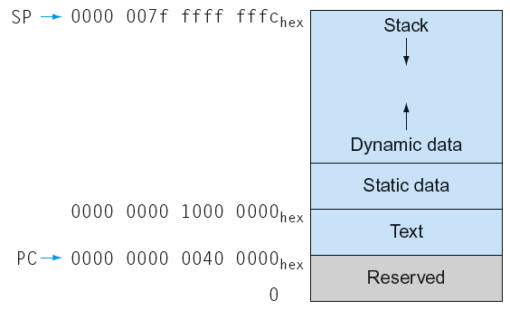
Memory Layout
Text: program code
Static data: global variables
  e.g., static variables in C, constant arrays and strings
Dynamic data: heap
  E.g., malloc in C, new in Java
Stack: automatic storage
Chapter 2 — Instructions: Language of the Computer — <number>
Notes:
The University of Adelaide, School of Computer Science
Chapter 2 — Instructions: Language of the Computer

Slide 40
Byte/Halfword Operations
LEGv8 byte/halfword load/store
  Load byte:
    LDURB Rt, [Rn, offset]
    Sign extend to 32 bits in rt
  Store byte:
    STURB Rt, [Rn, offset]
    Store just rightmost byte
  Load halfword:
    LDURH Rt, [Rn, offset]
    Sign extend to 32 bits in rt
  Store halfword:
    STURH Rt, [Rn, offset]
    Store just rightmost halfword
Chapter 2 — Instructions: Language of the Computer — <number>
Notes:
The University of Adelaide, School of Computer Science
Chapter 2 — Instructions: Language of the Computer

Slide 41
Branch Addressing
B-type
  B 10000 // go to location 10000_{ten}
CB-type
  CBNZ X19, Exit // go to Exit if X19 != 0
Both addresses are PC-relative
  Address = PC + offset (from instruction)
5
10000_{ten}
6 bits
26 bits
181
Exit
19
8 bits
19 bits
5 bits
Chapter 2 — Instructions: Language of the Computer — <number>
Notes:
The University of Adelaide, School of Computer Science
Chapter 2 — Instructions: Language of the Computer

Slide 42
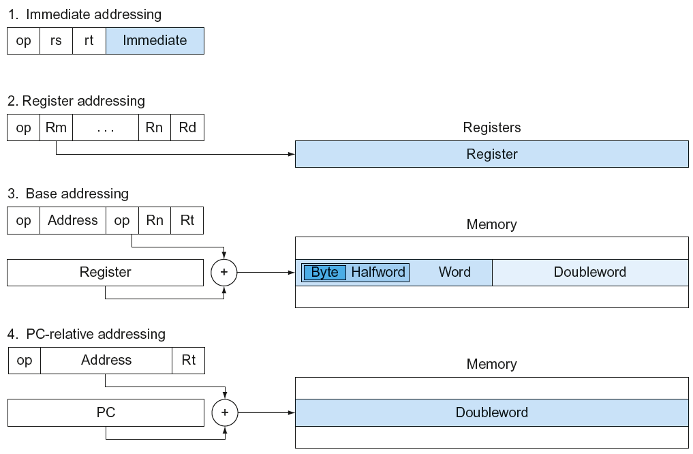
LEGv8 Addressing Summary
Chapter 2 — Instructions: Language of the Computer — <number>

Slide 43
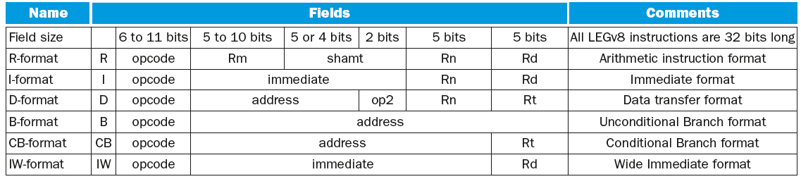
LEGv8 Encoding Summary
Chapter 2 — Instructions: Language of the Computer — <number>

Slide 44
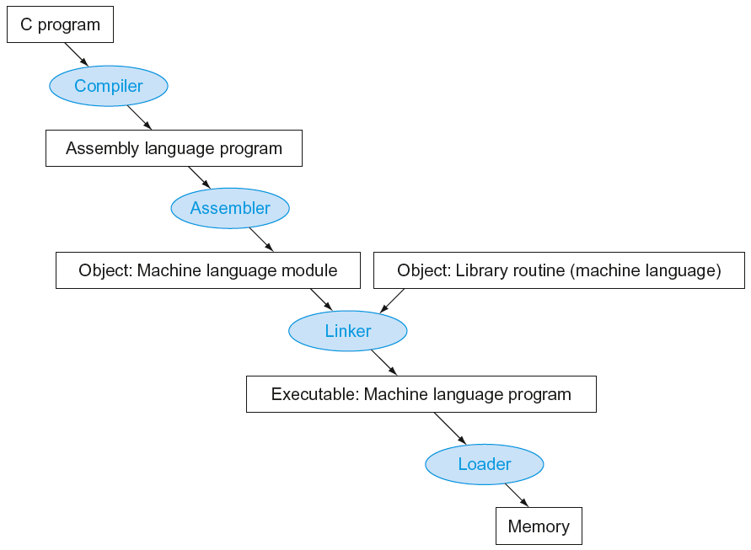
Translation and Startup
Many compilers produce object modules directly
§2.12 Translating and Starting a Program
Static linking
Chapter 2 — Instructions: Language of the Computer — <number>
Notes:
The University of Adelaide, School of Computer Science
Chapter 2 — Instructions: Language of the Computer

Slide 45
Producing an Object Module
Assembler (or compiler) translates program into machine instructions
Provides information for building a complete program from the pieces
  Header: described contents of object module
  Text segment: translated instructions
  Static data segment: data allocated for the life of the program
  Relocation info: for contents that depend on absolute location of loaded program
  Symbol table: global definitions and external refs
  Debug info: for associating with source code
Chapter 2 — Instructions: Language of the Computer — <number>
Notes:
The University of Adelaide, School of Computer Science
Chapter 2 — Instructions: Language of the Computer

Slide 46
Linking Object Modules
Produces an executable image
  1. Merges segments
  2. Resolve labels (determine their addresses)
  3. Patch location-dependent and external refs
Could leave location dependencies for fixing by a relocating loader
  But with virtual memory, no need to do this
  Program can be loaded into absolute location in virtual memory space
Chapter 2 — Instructions: Language of the Computer — <number>
Notes:
The University of Adelaide, School of Computer Science
Chapter 2 — Instructions: Language of the Computer

Slide 47
Loading a Program
Load from image file on disk into memory
  1. Read header to determine segment sizes
  2. Create virtual address space
  3. Copy text and initialized data into memory
    Or set page table entries so they can be faulted in
  4. Set up arguments on stack
  5. Initialize registers (including SP, FP)
  6. Jump to startup routine
    Copies arguments to X0, … and calls main
    When main returns, do exit syscall
Chapter 2 — Instructions: Language of the Computer — <number>
Notes:
The University of Adelaide, School of Computer Science
Chapter 2 — Instructions: Language of the Computer

Slide 48
Dynamic Linking
Only link/load library procedure when it is called
  Requires procedure code to be relocatable
  Avoids image bloat caused by static linking of all (transitively) referenced libraries
  Automatically picks up new library versions
Chapter 2 — Instructions: Language of the Computer — <number>
Notes:
The University of Adelaide, School of Computer Science
Chapter 2 — Instructions: Language of the Computer

Slide 49
The Intel x86 ISA
Evolution with backward compatibility
  8080 (1974): 8-bit microprocessor
    Accumulator, plus 3 index-register pairs
  8086 (1978): 16-bit extension to 8080
    Complex instruction set (CISC)
  8087 (1980): floating-point coprocessor
    Adds FP instructions and register stack
  80286 (1982): 24-bit addresses, MMU
    Segmented memory mapping and protection
  80386 (1985): 32-bit extension (now IA-32)
    Additional addressing modes and operations
    Paged memory mapping as well as segments
§2.17 Real Stuff: x86 Instructions
Chapter 2 — Instructions: Language of the Computer — <number>
Notes:
The University of Adelaide, School of Computer Science
Chapter 2 — Instructions: Language of the Computer

Slide 50
The Intel x86 ISA
Further evolution…
  i486 (1989): pipelined, on-chip caches and FPU
    Compatible competitors: AMD, Cyrix, …
  Pentium (1993): superscalar, 64-bit datapath
    Later versions added MMX (Multi-Media eXtension) instructions
    The infamous FDIV bug
  Pentium Pro (1995), Pentium II (1997)
    New microarchitecture (see Colwell, The Pentium Chronicles)
  Pentium III (1999)
    Added SSE (Streaming SIMD Extensions) and associated registers
  Pentium 4 (2001)
    New microarchitecture
    Added SSE2 instructions
Chapter 2 — Instructions: Language of the Computer — <number>
Notes:
The University of Adelaide, School of Computer Science
Chapter 2 — Instructions: Language of the Computer

Slide 51
The Intel x86 ISA
And further…
  AMD64 (2003): extended architecture to 64 bits
  EM64T – Extended Memory 64 Technology (2004)
    AMD64 adopted by Intel (with refinements)
    Added SSE3 instructions
  Intel Core (2006)
    Added SSE4 instructions, virtual machine support
  AMD64 (announced 2007): SSE5 instructions
    Intel declined to follow, instead…
  Advanced Vector Extension (announced 2008)
    Longer SSE registers, more instructions
If Intel didn’t extend with compatibility, its competitors would!
  Technical elegance ≠ market success
Chapter 2 — Instructions: Language of the Computer — <number>
Notes:
The University of Adelaide, School of Computer Science
Chapter 2 — Instructions: Language of the Computer

Slide 52

Basic x86 Registers
Chapter 2 — Instructions: Language of the Computer — <number>
Notes:
The University of Adelaide, School of Computer Science
Chapter 2 — Instructions: Language of the Computer

Slide 53
Basic x86 Addressing Modes
Two operands per instruction
Source/dest operand | Second source operand
Register | Register
Register | Immediate
Register | Memory
Memory | Register
Memory | Immediate
Memory addressing modes
  Address in register
  Address = R_{base} + displacement
  Address = R_{base} + 2^{scale} × R_{index} (scale = 0, 1, 2, or 3)
  Address = R_{base} + 2^{scale} × R_{index} + displacement
Chapter 2 — Instructions: Language of the Computer — <number>
Notes:
The University of Adelaide, School of Computer Science
Chapter 2 — Instructions: Language of the Computer

Slide 54
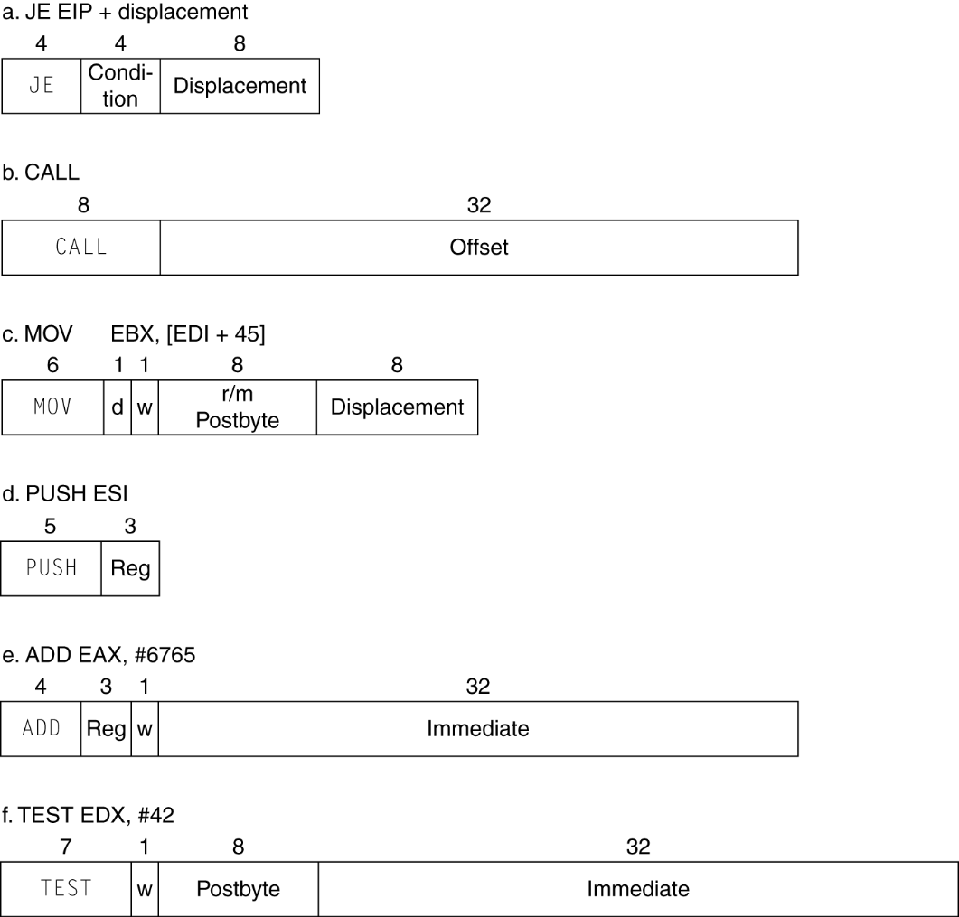
x86 Instruction Encoding
Variable length encoding
  Postfix bytes specify addressing mode
  Prefix bytes modify operation
    Operand length, repetition, locking, …
Chapter 2 — Instructions: Language of the Computer — <number>
Notes:
The University of Adelaide, School of Computer Science
Chapter 2 — Instructions: Language of the Computer

Slide 55
Implementing IA-32
Complex instruction set makes implementation difficult
  Hardware translates instructions to simpler microoperations
    Simple instructions: 1–1
    Complex instructions: 1–many
  Microengine similar to RISC
  Market share makes this economically viable
Comparable performance to RISC
  Compilers avoid complex instructions
Chapter 2 — Instructions: Language of the Computer — <number>
Notes:
The University of Adelaide, School of Computer Science
Chapter 2 — Instructions: Language of the Computer

Slide 56
Fallacies
Powerful instruction ⇒ higher performance
  Fewer instructions required
  But complex instructions are hard to implement
    May slow down all instructions, including simple ones
  Compilers are good at making fast code from simple instructions
Use assembly code for high performance
  But modern compilers are better at dealing with modern processors
  More lines of code ⇒ more errors and less productivity
§2.19 Fallacies and Pitfalls
Chapter 2 — Instructions: Language of the Computer — <number>
Notes:
The University of Adelaide, School of Computer Science
Chapter 2 — Instructions: Language of the Computer

Slide 57

Fallacies
Backward compatibility ⇒ instruction set doesn’t change
  But they do accrete more instructions
x86 instruction set
Chapter 2 — Instructions: Language of the Computer — <number>
Notes:
The University of Adelaide, School of Computer Science
Chapter 2 — Instructions: Language of the Computer

Slide 58
Concluding Remarks
Design principles
  1. Simplicity favors regularity
  2. Smaller is faster
  3. Make the common case fast
  4. Good design demands good compromises
Layers of software/hardware
  Compiler, assembler, hardware
LEGv8: typical of RISC ISAs
  c.f. x86
§2.20 Concluding Remarks
Chapter 2 — Instructions: Language of the Computer — <number>
Notes:
The University of Adelaide, School of Computer Science
Chapter 2 — Instructions: Language of the Computer

Slide 59
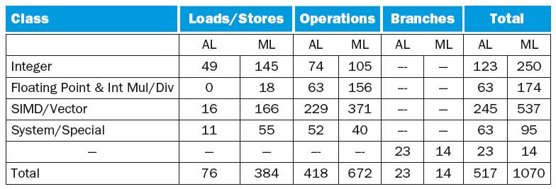
Concluding Remarks
Additional ARMv8 features:
  Flexible second operand
  Additional addressing modes
  Conditional instructions (e.g. CSET, CINC)
Chapter 2 — Instructions: Language of the Computer — <number>
Notes:
The University of Adelaide, School of Computer Science
Chapter 2 — Instructions: Language of the Computer

